Slide 1
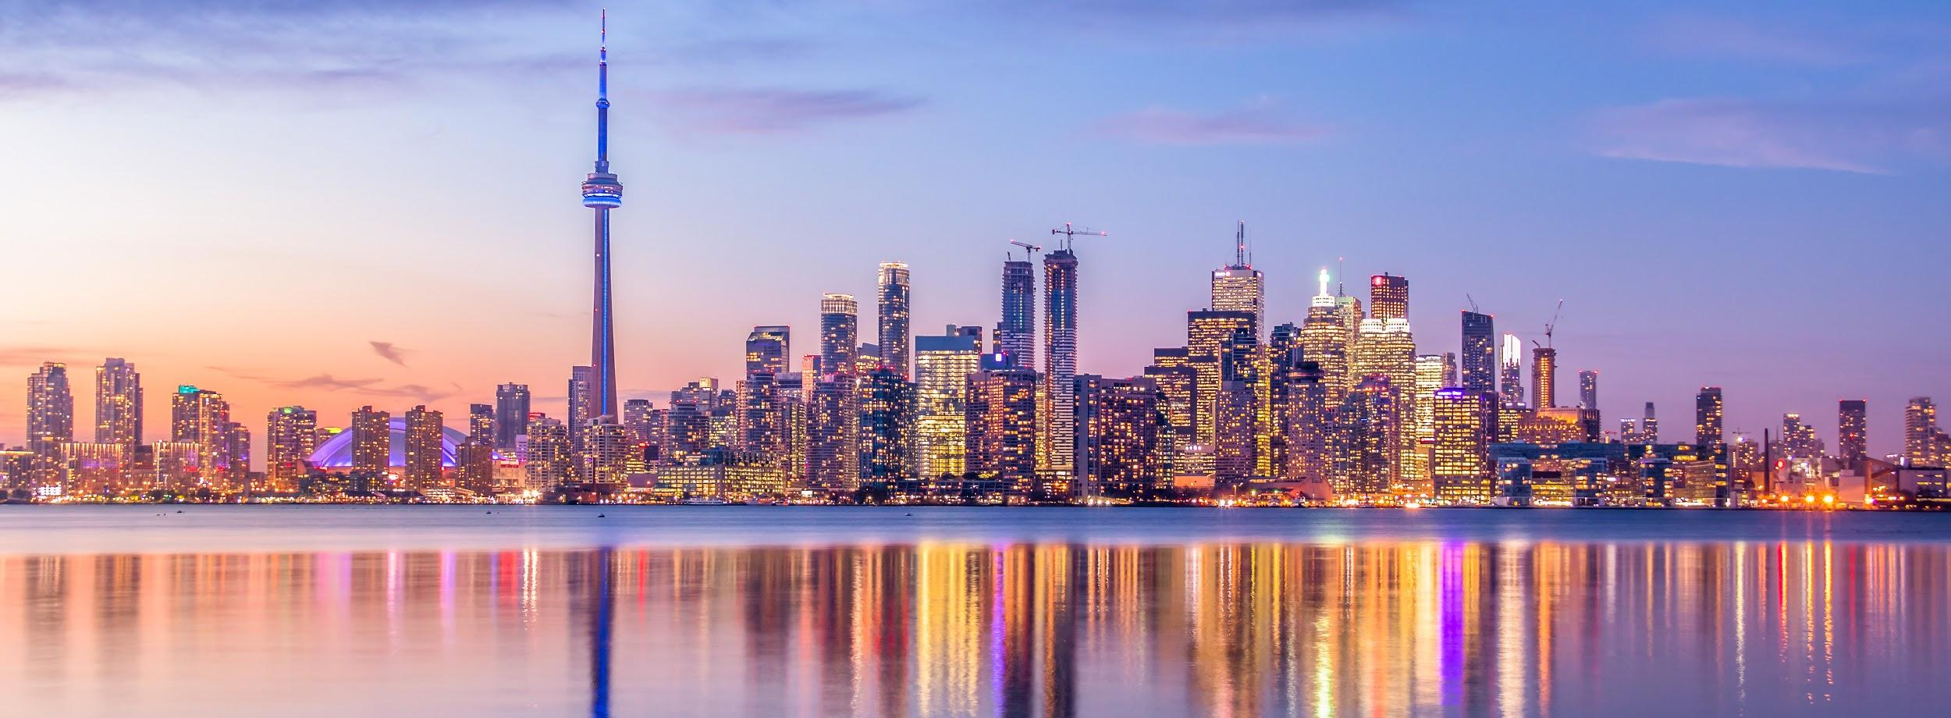
GTA—Vice City:
An Analysis of Recreational Substance Use from Local to National Scale

Slide 2
Introduction
What is the state of substance use look like in Canada?
What effect is this having on us?
Cannabis consumption
Alcohol consumption
Markers of well-being
Graduation rate of high school students
Impaired driving incidents
Hospitalizations
Income

Slide 3
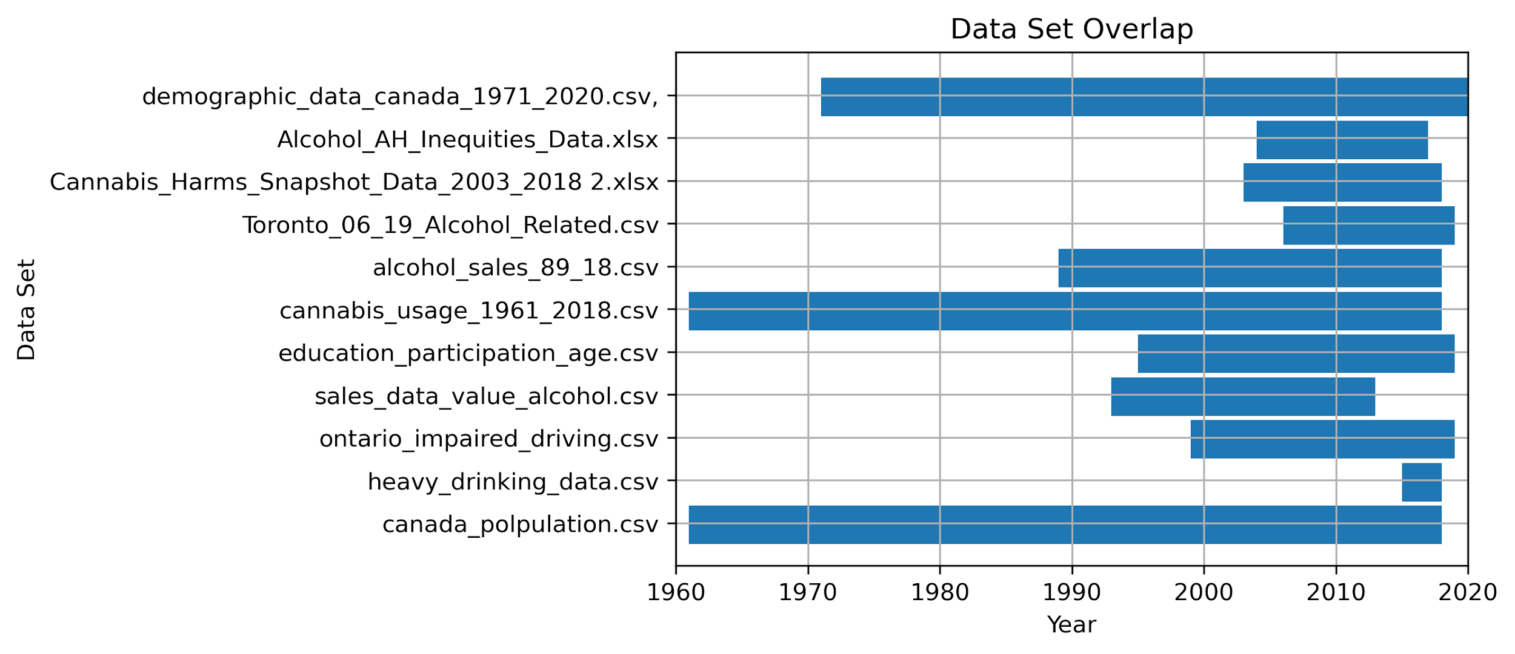
Data sources
The majority of the historical data that we gathered was from STATSCAN
Limitations:
Overlap is small
Cannabis usage relies on self-reporting
Few APIs/dynamic datasets
Notes:
Most of our data was gathered from STATSCAN or ontario government database
We were able to find some overlap but hard to do with the historical data
On the right is a gantt chart showing our overlap of the data sources we used

Slide 4
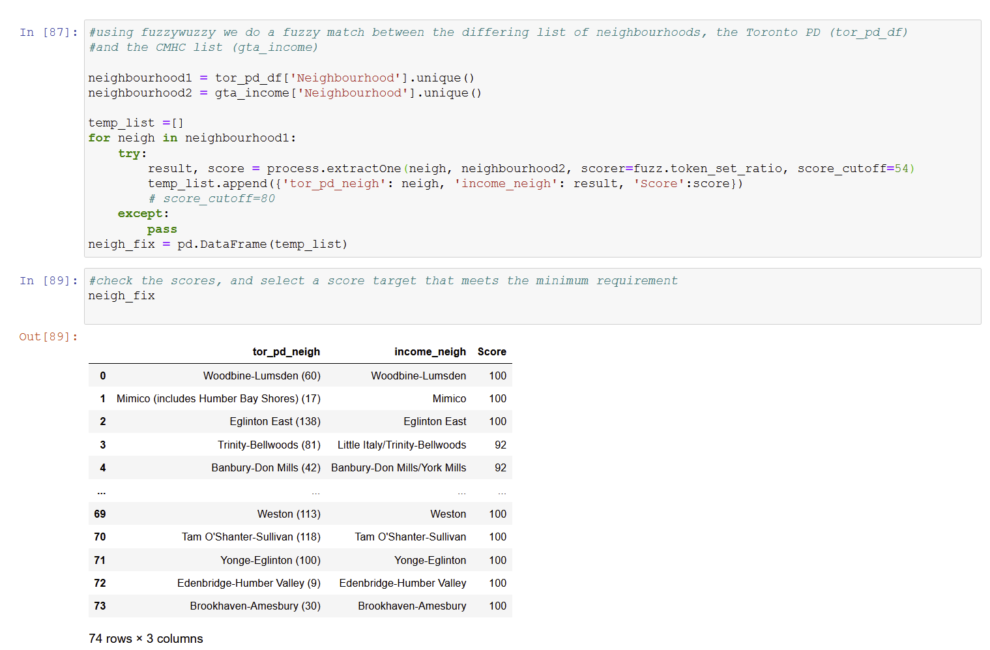
fuzzywuzzy - Fuzzy Logic Matching
Notes:
StatsCan had a fairly consistent dataset, but two of our datasets, Toronto PD and CMHC did not
One of the aspects of data cleaning is that there are at time mismatches of names, or that barrelled names are in slightly different sequences. Using the fuzzywuzzy package, I did a fuzzy logic name matching from 2 different sources ; As we see here in the tor_pd_neigh column from the Toronto police, the sequences also include the neighbour numberings while the income_neigh from CMHC does not.
There are two issues with this, one is just that sometimes the data isn’t exactly the same; Toronto PD and CMHC had different neighbourhoods, as the CMHCs was counting all of the GTA. Secondly some of the names didn’t meet the score cutoff. This cutoff was created manually. If the dataset is small enough, you should randomly look at the name match scores, and find the last reasonable match. In my dataset, that score was 54.

Slide 5
Alcohol Consumption

Slide 6
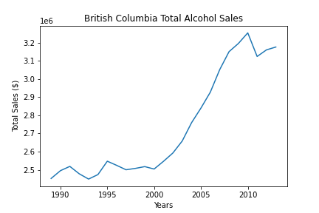
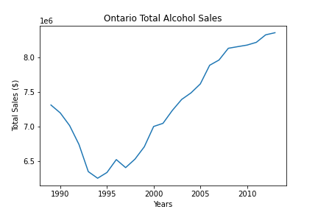
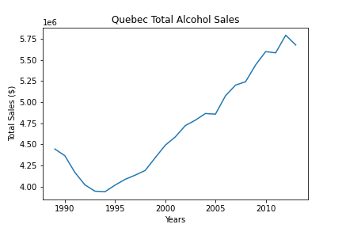
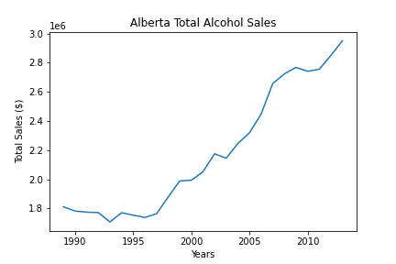
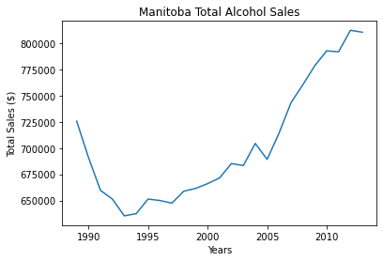
Alcohol Consumption Over time by Province
Notes:
Was difficult to get data on alc consumption so Used alcohol sales instead of consumption so making the assumption that increase in alc sales = increase in alc consumption
Alc sales are increasing every year for each province
The total alcohol sales are greater for provinces with the largest populations

Slide 7
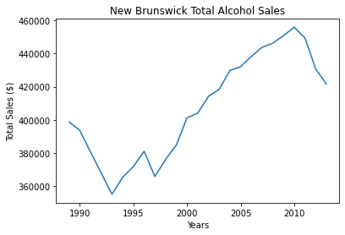
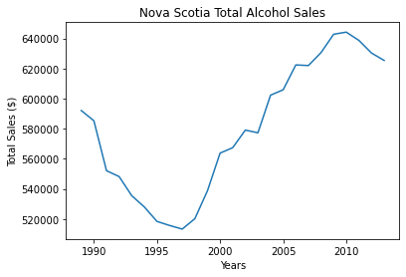
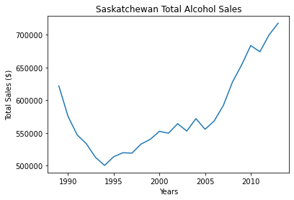
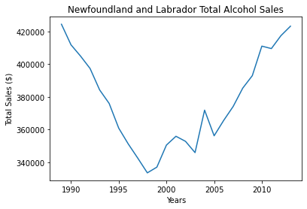
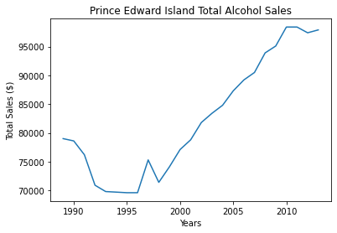
Alcohol Consumption Over time by Province

Slide 8
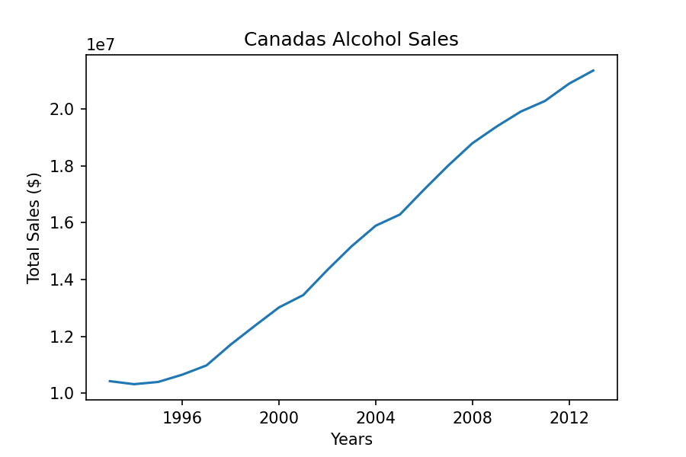
Canada's Alcohol Consumption
Notes:
Canadas alc sales increasing by year which is similar to how the larger population provinces sales are increasing

Slide 9
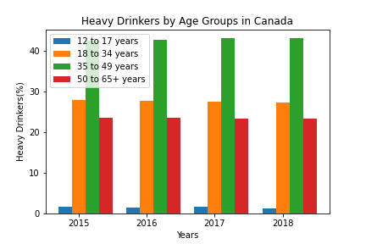
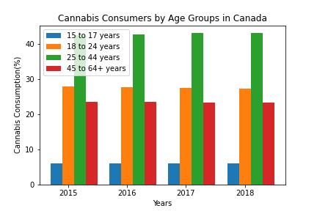
Notes:
Heavy drinkers are classified as individuals who drink 15 or more drinks/week
The age group 35-49 make up most of the heavy drinker population
The majority of cannabis users in canada are between the ages 25-44. Similar to heavy drinkers

Slide 10
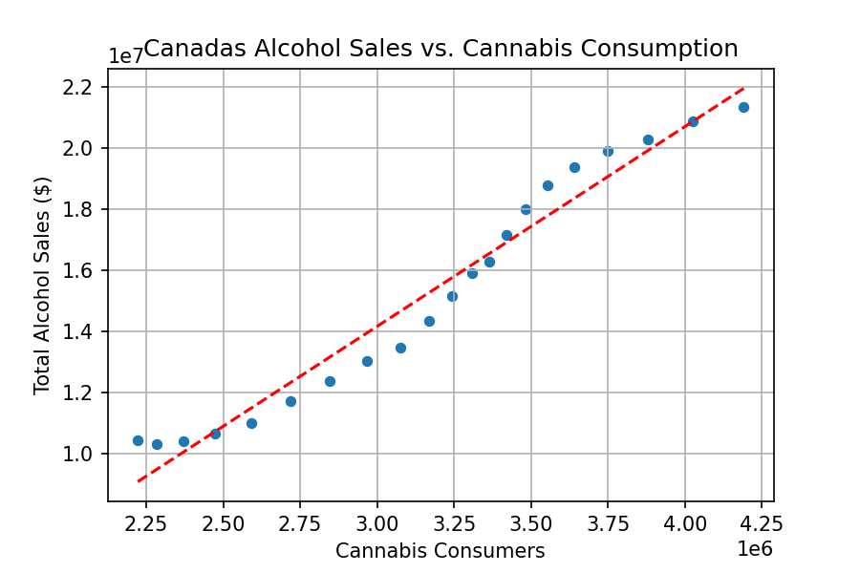
Notes:
Assuming that the ppl who are buying alc are drinking, can't really make a definitive correlation but just showing relationship
Positive relationship → As alcohol sales are increasing so are cannabis users

Slide 11
Cannabis Consumption

Slide 12
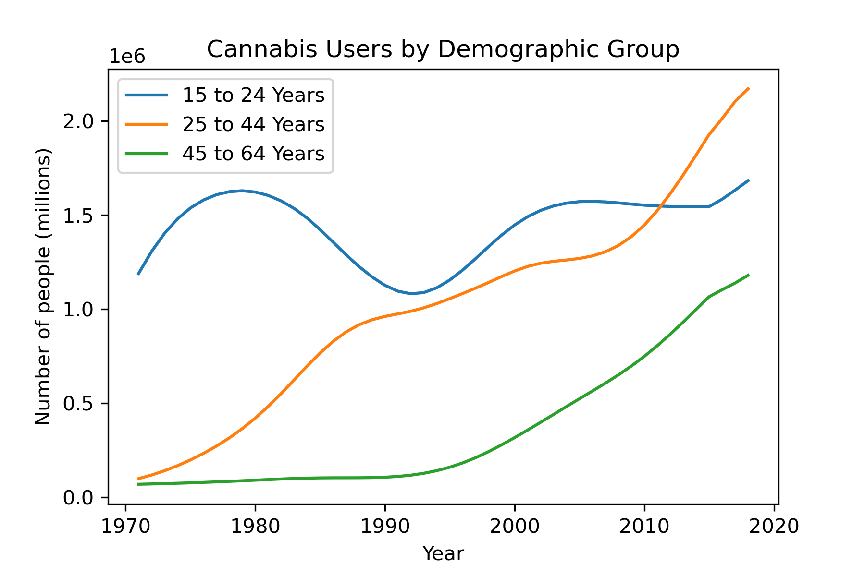
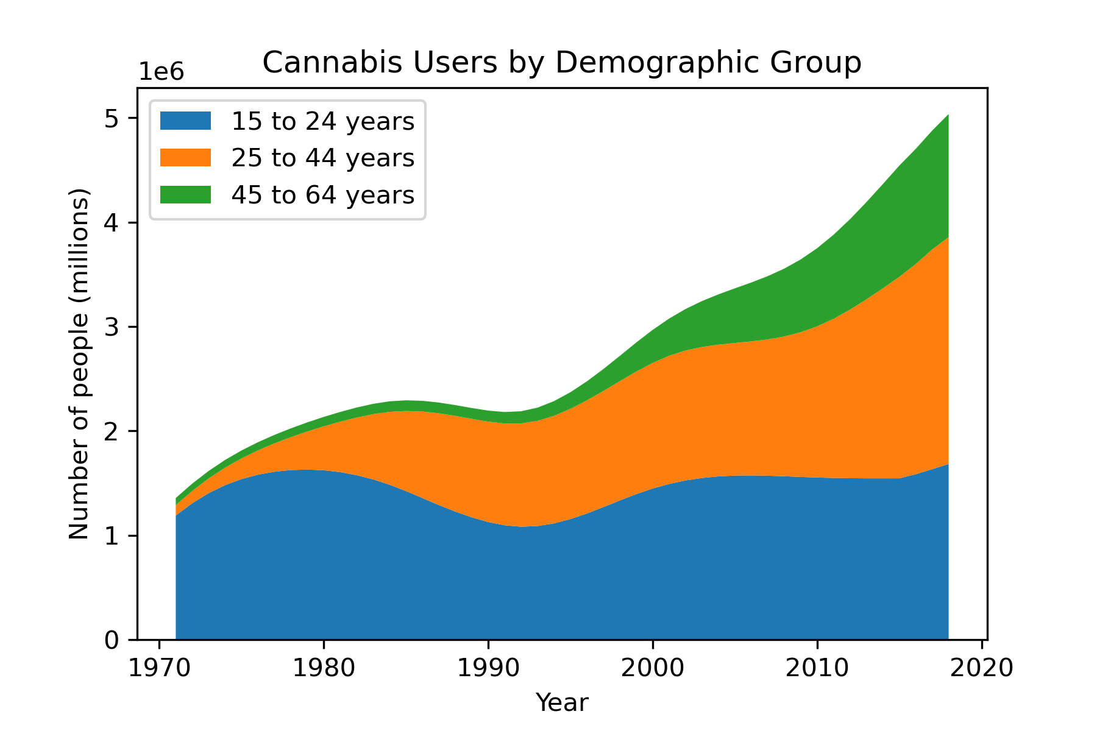

Slide 13
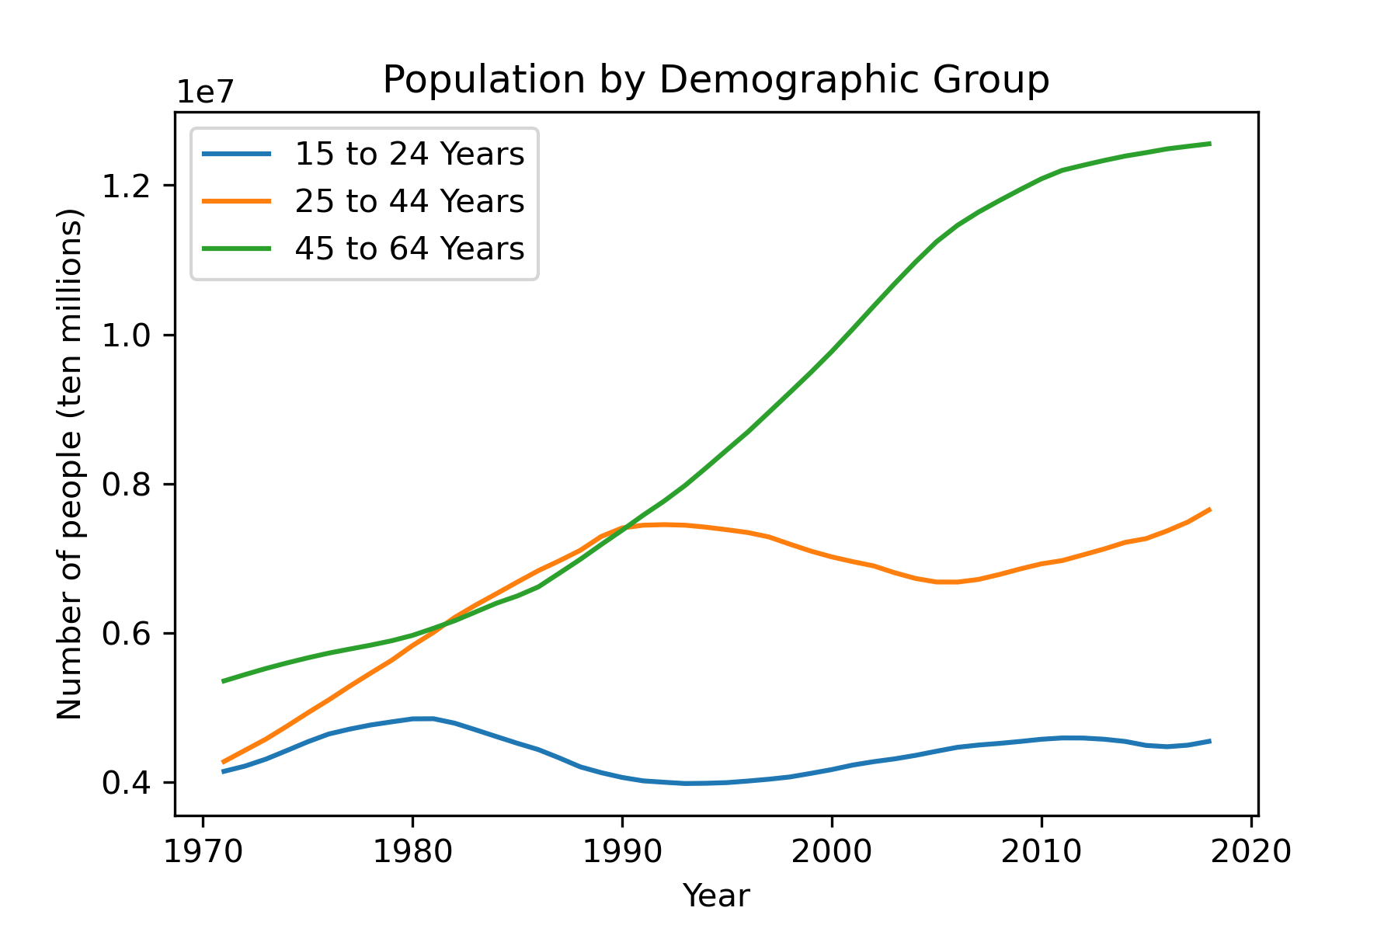

Slide 14
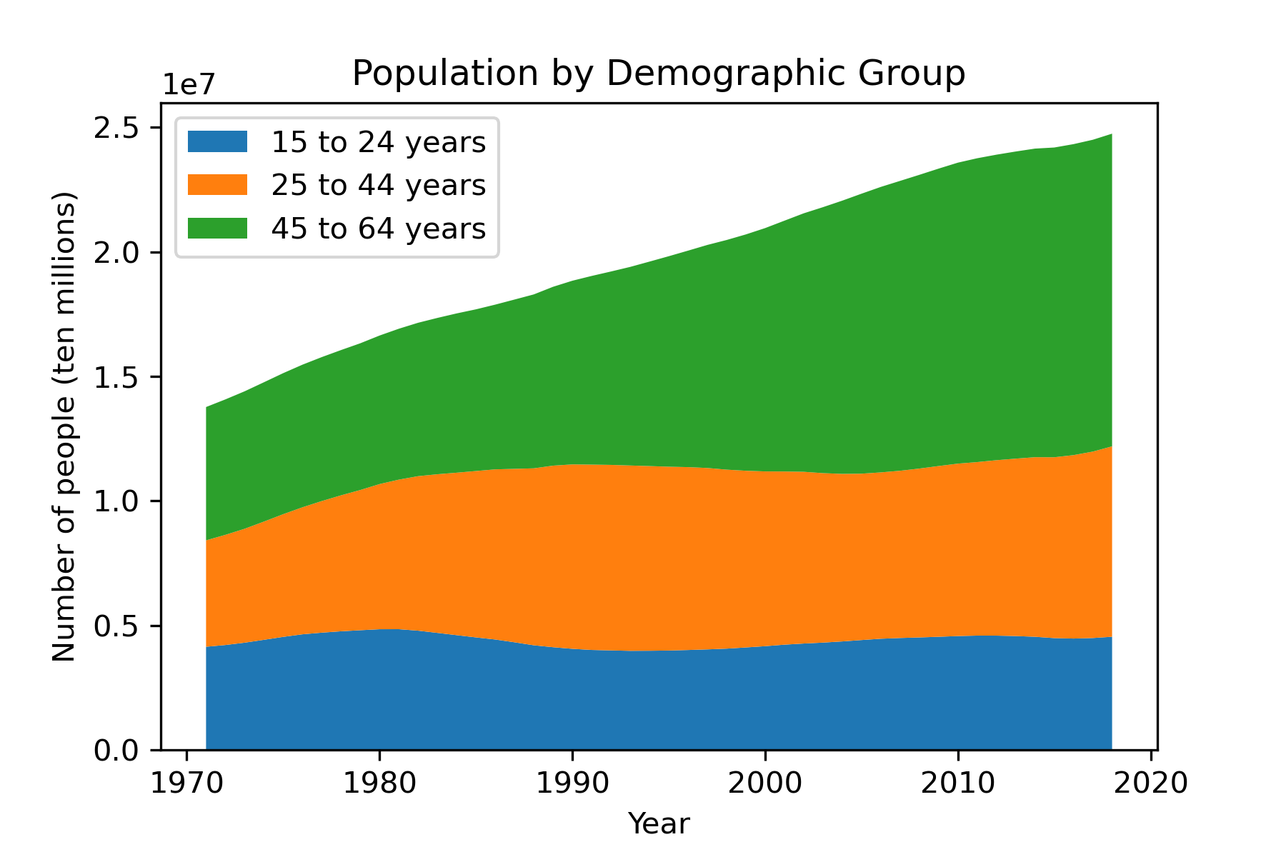

Slide 15
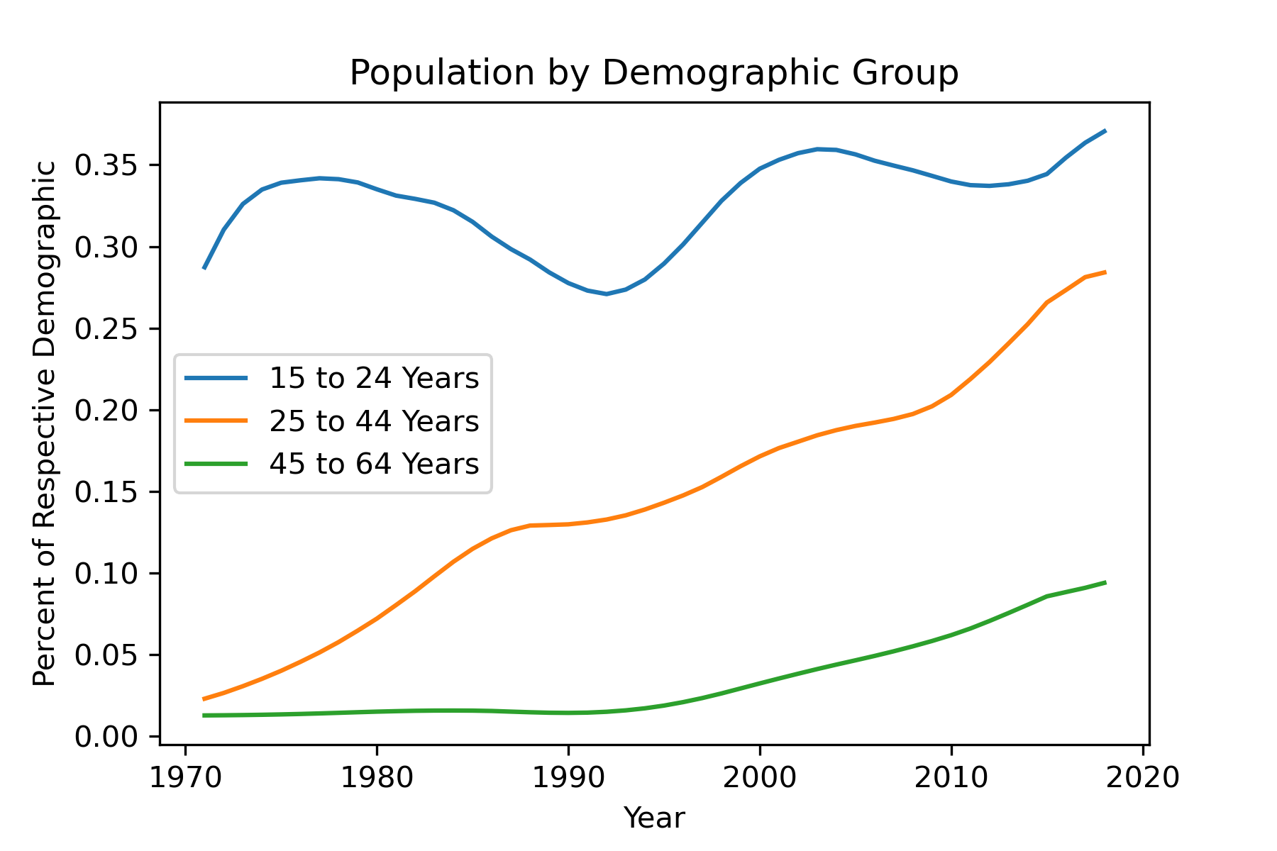
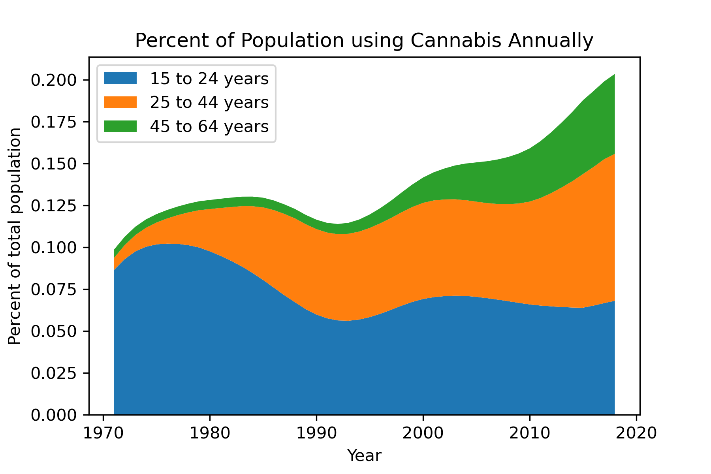

Slide 16
Graduation Rate
Notes:
Looking at Alcohol and cannabis and their effect on graduation rates

Slide 17
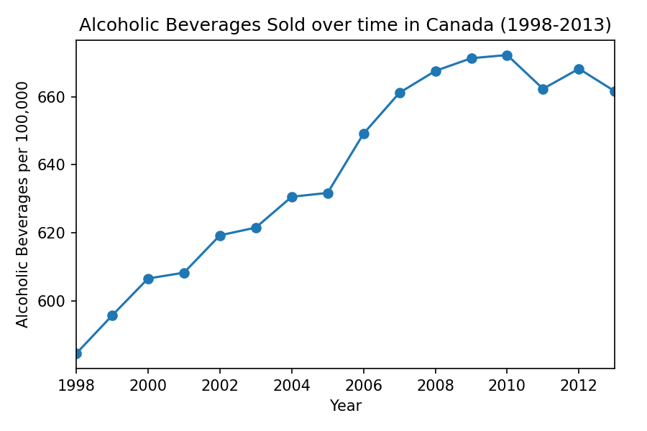
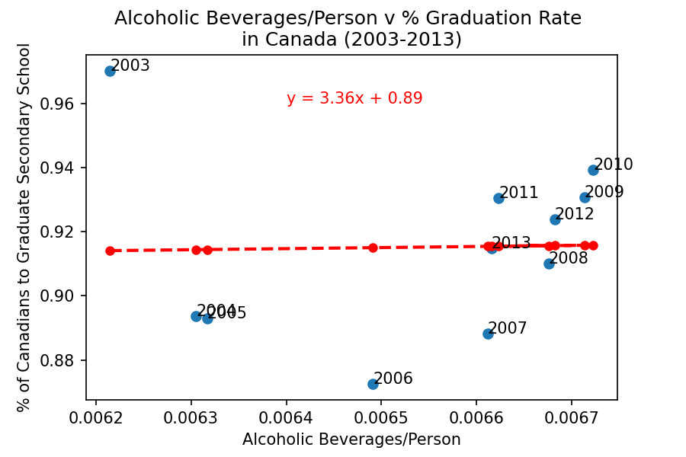
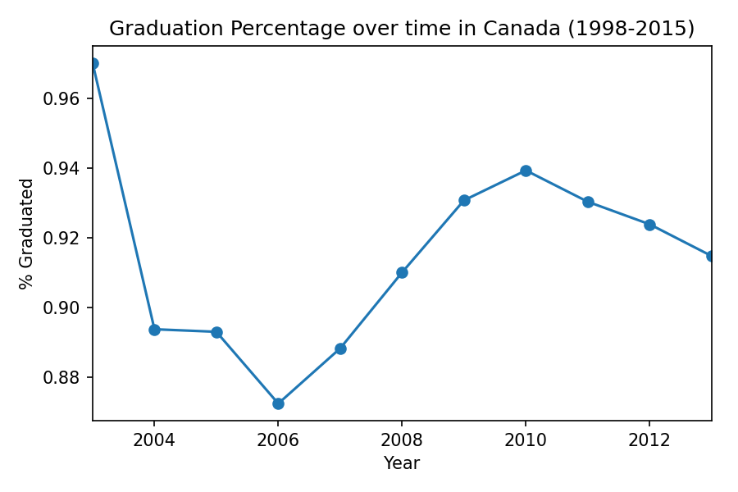
Alcohol Sales/Person and Grad Rate R-value: 0.0221
Notes:
Data from 1998-2013
Alcoholic: steadily increases
Grad %
Relationship: almost no relationship between these two

Slide 18
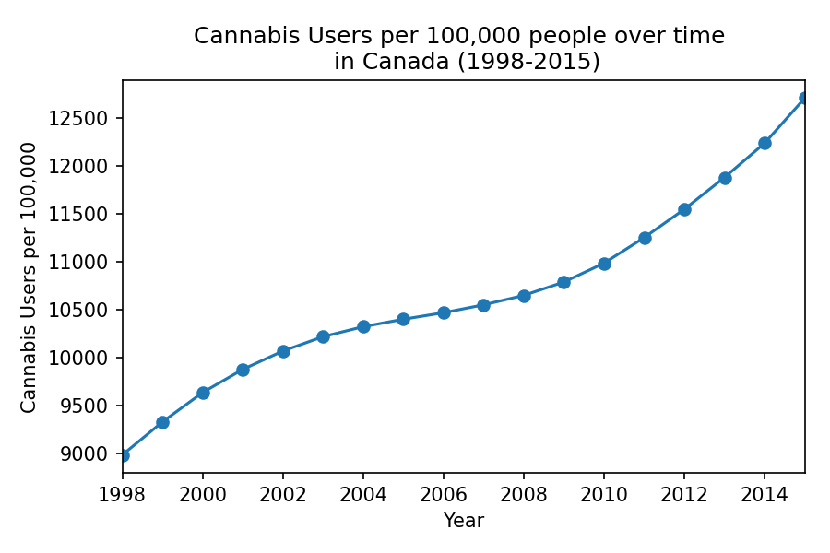
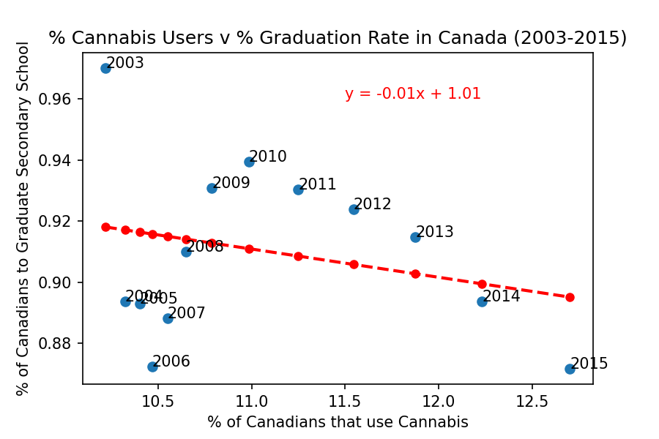
Cannabis user % and Grad Rate R-value: -0.2576
Notes:
Data from 1998-2015
Cannabis use: steadily increases over time
Grad%
Relationship: mostly driven by graduation %

Slide 19
Impaired Driving

Slide 20
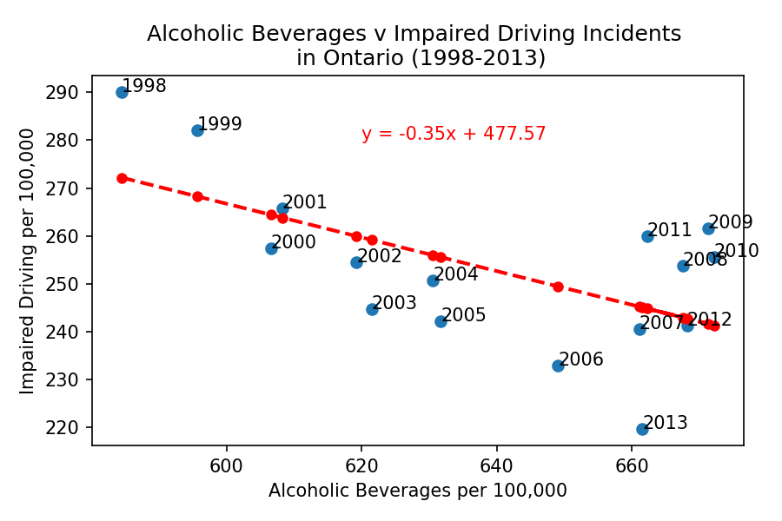
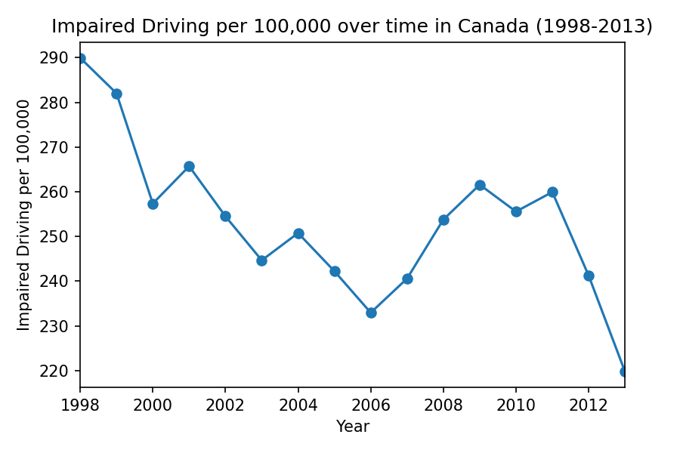
Alcohol Sales/Person and Impaired Driving Incidents R-value: -0.5997
Notes:
Alcoholic beverages
Impaired driving: steadily decreasing
Relationship: the increase in alcohol sales hasnt led to an increase in impaired driving incidents

Slide 21
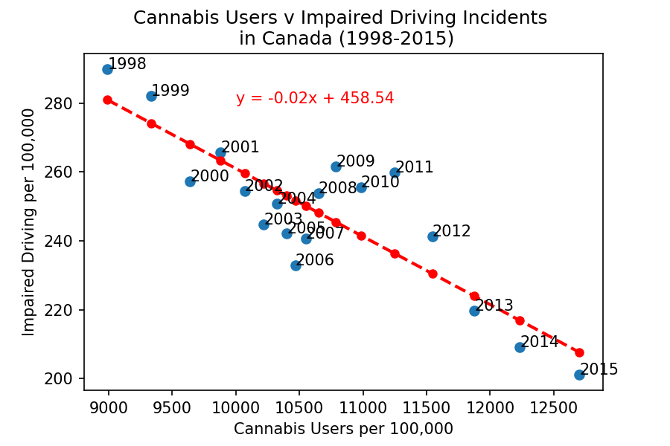
Cannabis use and Impaired Driving R-value: -0.8575
Notes:
Cannabis use has increased while impaired driving has decreased
The scatter shows that there is a strong negative correlation between these two

Slide 22
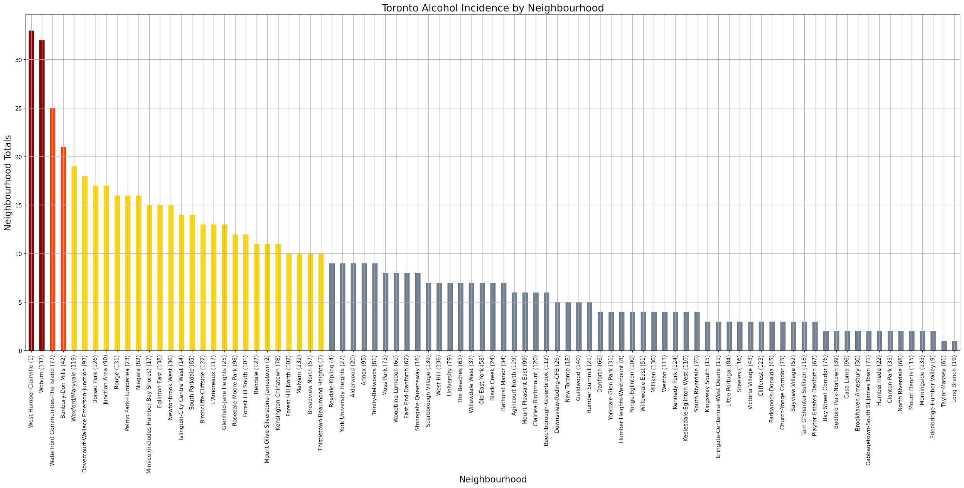
Impaired Driving
Notes:
The question here was Impaired Driving vs Income
Here we see the impaired driving total incidences from 2006-2019, with the exception of the Waterfront / Island communities because of a larger than normal distribution of bars, restaurants, and their hub as a destination… The top two neighbourhoods, are neighbourhoods with low median incomes.

Slide 23
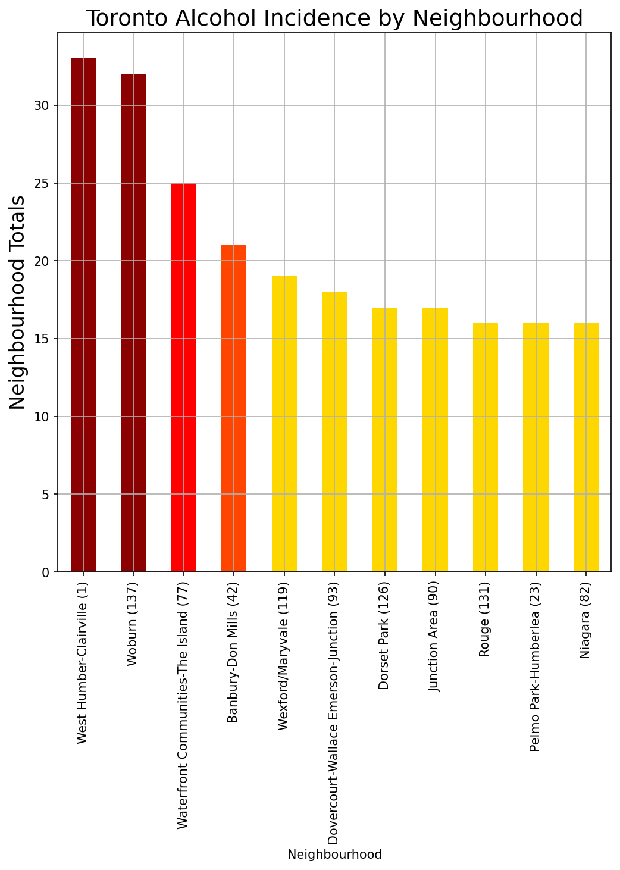
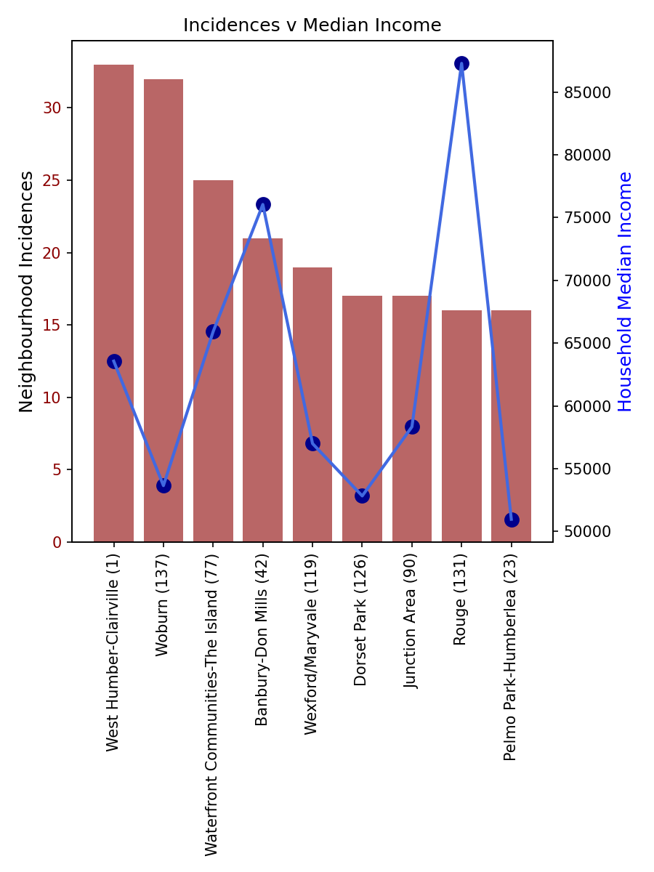
Neighbourhoods with High Alcohol Incidences
r-value: -0.1576
Toronto
r-value: 0.0233
Notes:
Looking at the neighbourhoods with the highest incidences, we matched to those we had in the CMHC. If we look at only the first top 2 neighbourhoods there seems to be correlation but that falls apart with the rest of the points. One of the limitations of the data is that the CHMC data is only for 2016, it doesn’t take into account the median age of the residents.

Slide 24
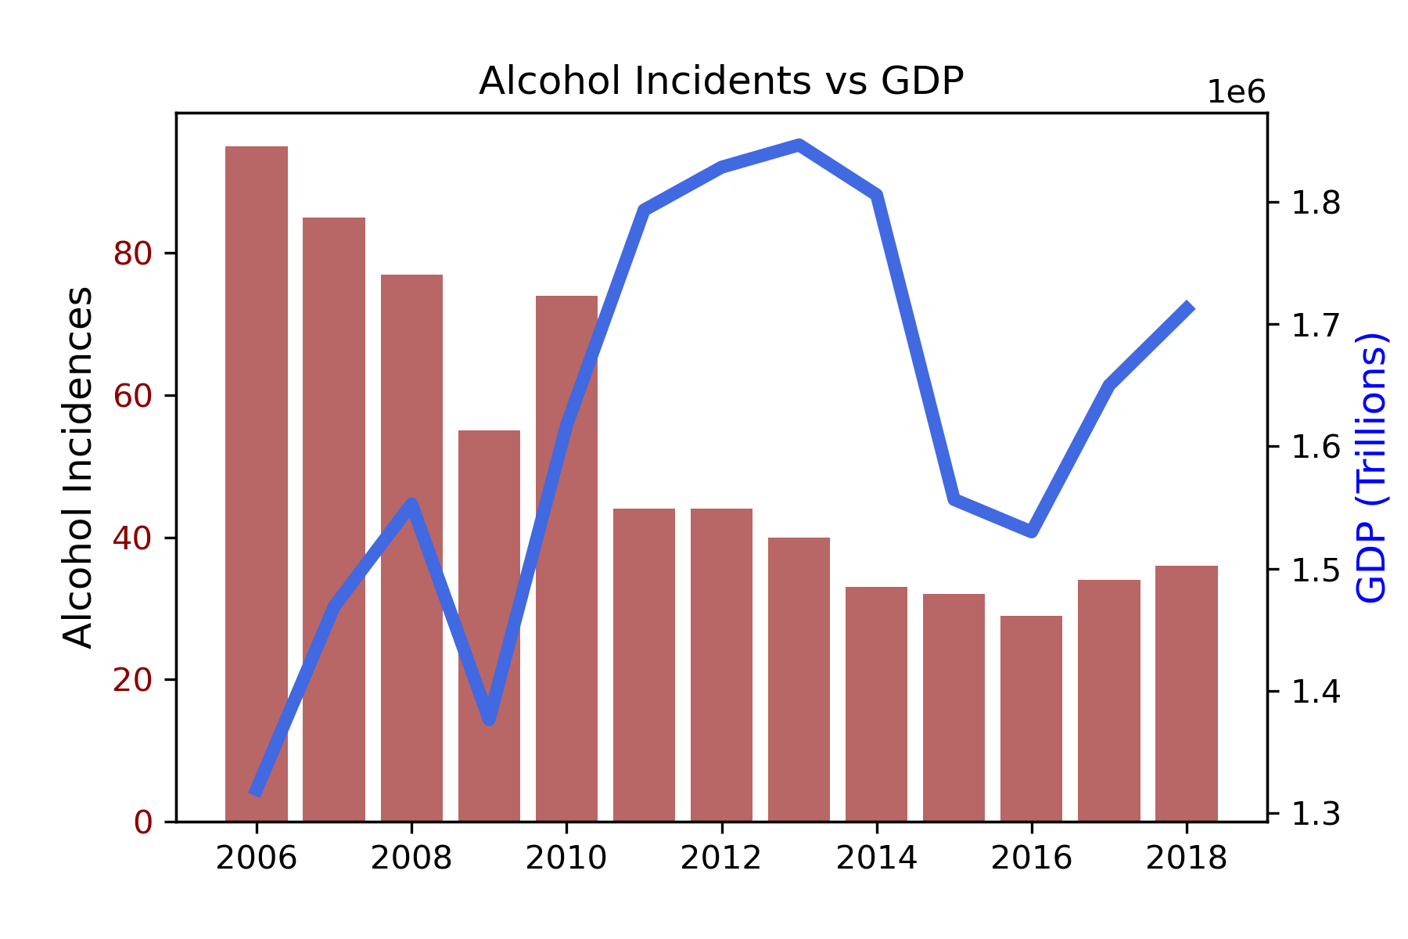
Neighbourhoods with highest total alcohol usage
r-value : -0.6022
Notes:
If we look at the whole of Toronto over a longer time span, and using the GDP as an indicator the r-value jumps to something more reasonable. And as we see as the GDP has risen, total incidences of alcohol related crime has fallen.

Slide 25
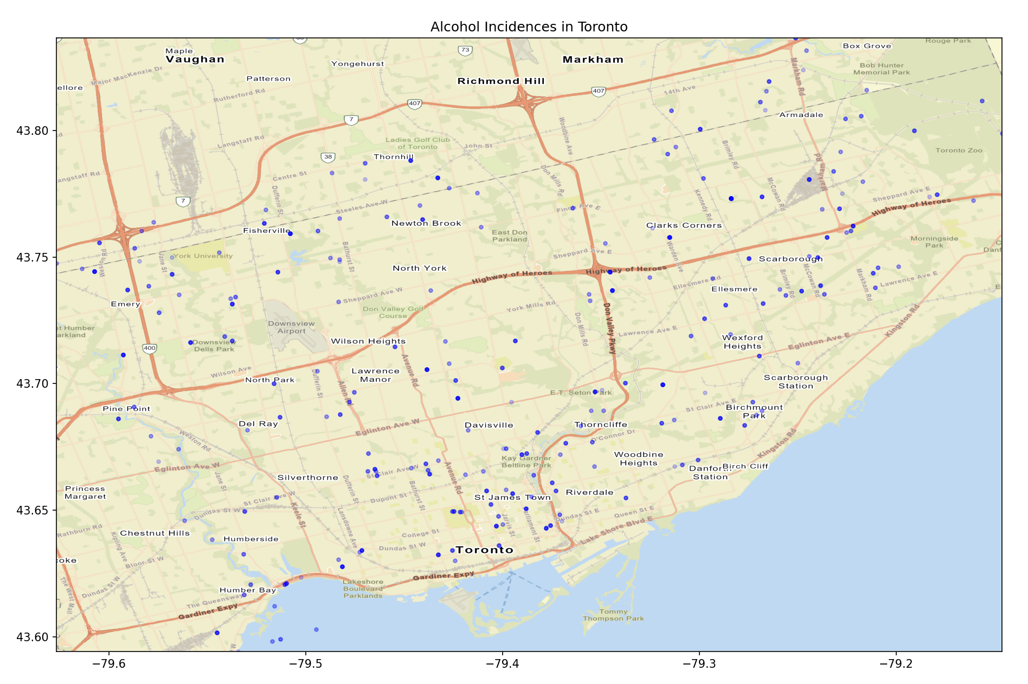
Map of Incidences
Notes:
Lastly, I mapped out the points. The darker the points the higher the number of incidences. We can see a cluster of points in the St. James Town area, Birchmount Park, and Scarbough.
Lastly if you look closely, we have points in the lake. Those are usually on the party ships, or leisure craft incidences.

Slide 26
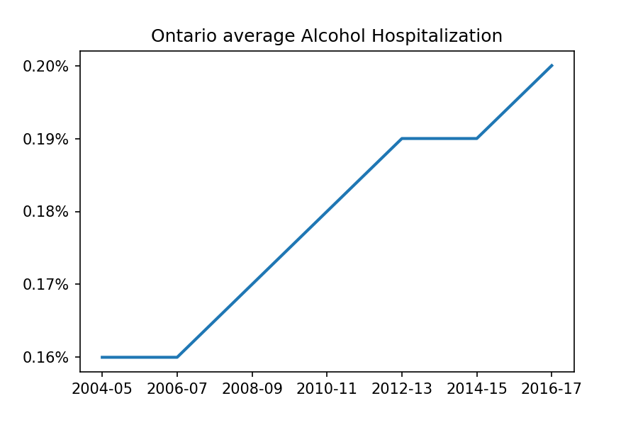
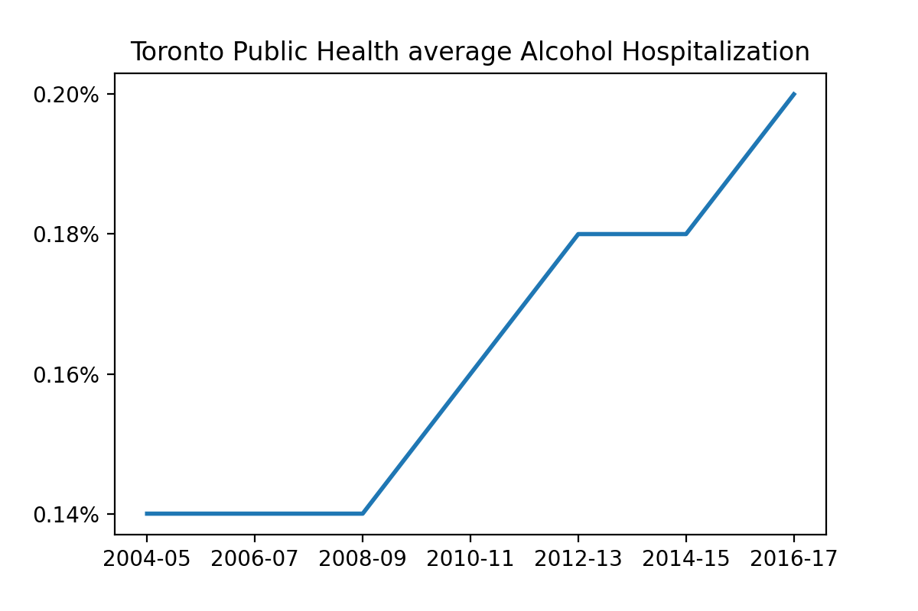
Hospitalizations
Notes:
These percentages are based the health region populations
Alcohol related hospitalizations have increased year over year, with similar trends in showing in ontario as whole and toronto in itself.

Slide 27
Conclusion
Sales for Alcohol have increased year over year with greater average sales in higher populated provinces
On Average, there is an increase in alcohol attributed hospitalizations year over year
Cannabis consumption as whole have increased in Canada
Cannabis usage has grown among older age groups (24-44, 45-65), while remaining steady among younger age groups (15-24)
Negative correlation between increased cannabis usage and impaired driving incidents
Insufficient evidence to show a correlation between cannabis/alcohol usage and graduation rate
Notes:
To sum everything up
Sales for Alcohol have increased year over year with greater average sales in higher populated provinces--As well as an increase in alcohol attributed hospitalizations year over year
Cannabis consumption as whole has increased in Canada with greater growth among older age groups (24-44, 45-65), while remaining steady among younger age groups (15-24)
Negative correlation between increased cannabis usage and impaired driving incidents
Insufficient evidence to show a correlation between cannabis/alcohol usage and graduation rate
Final point, drinking and driving bad idea, good idea, going to the gym, reading a book
-

Slide 28
Post Mortem
Historical data is boring
Difficult to draw true correlations from dataset
Next time would like to use more APIs for data
Notes:
Since used many datasets, difficult to draw true correlations
If had more/greater data we would be able to draw better correlations/causations
CMHC vs Toronto PD didn’t share the same names, so some data may have to be parsed manually
Use apis To make data more fun, the data we used was very stagnant

